Slide 1


Design of Antenna for Automotive
Applications
AY 2020-24
GITAM UNIVERSITY
Capstone Project
Project ID: PROJ2999
A University should be a place of light, of liberty, and of learning.
Department of Electrical Electronics and Communication Engineering
Project Team:
G. Pavan Kumar
Shaik. Ismail
J. Guru Charan Singh
Project Mentor:
S. Durga Padmaja Bikkuri
www.gitamedu.com

Slide 2




Project Group – Details
Photo
Track
Roll No
Name
EECE AI/ML
BU21EECE0100354
G. Pavan Kumar
EECE AI/ML
BU21EECE0100095
Shaik. Ismail
EECE AI/ML
BU21EECE0100365
J. Guru Charan Singh

Slide 3
Objective and Goals
Objective
Design a vertically polarized PIFA antenna for automotive applications, operating in the 3.4-3.8 GHz 5G band to provide Wi-Fi connectivity.
Goals
Main Goals
To Design 3.4-3.8 GHz PIFA antenna for vehicle roofs with omnidirectional coverage
Build, test, and refine the antenna prototype for optimal real-world automotive performance.
Exploration of Ansys HFSS software

Slide 4
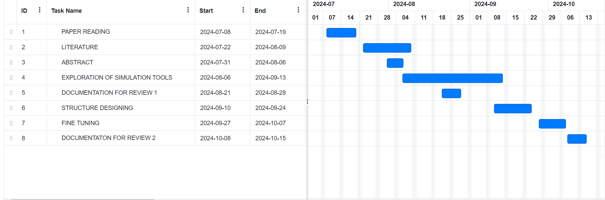
PROJECT PLAN

Slide 5
Literature Survey
S.NO | TITLE | AUTHOR | YEAR OF PUBLISHING | PARAMETERS MENTIONED
1 | Multiband Omnidirectional Antenna for Sub-6 GHz 5G Automotive Applications | Jinliang Lian, Jiade Yuan | 2023 | Design: Printed monopole antenna with L-shaped branch, parasitic strips, circular ring resonator, and inverted C-shaped slot. Substrate: FR4, 1.6 mm thickness. Frequency Ranges: Lower: 0.82-1.01 GHz Mid: 1.68-2.75 GHz Upper: 3.27-4.21 GHz High: 4.77-4.91 GHz Applications: Supports 2G, 3G, 4G, and 5G frequencies; compact and cost-effective design.
2 | Modeling and Designed of a Monopole Antenna that Operate at 3.3 [GHz] for Future 5G sub 6 [GHz] | Gholam D Aghashirin, MagedKafafy, Hoda S. Abdel-A. Zohdy, Mohamed A. Zohdy, Adam Timmons | 2021 | Parameters: Frequency (0.6-5.9256 GHz), antenna length (23 mm). Substrates: Conducting ground plane. Design: Low-profile 5G antenna using FEKO software Purpose: Optimize 5G communication in vehicles.

Slide 6
Literature Survey
3 | Design of Shark Fin Integrated Antenna Systems for Automotive Applications | C. Damien & R. Sarkis | 2019 | Parameters: Frequency bands (690-2700 MHz, 5.9 GHz), antenna dimensions. Substrates: FR-4 substrate for V2V and Wi-Fi antennas. Design: Compact multiport antenna system integrated in a shark-fin case. Purpose: Support MIMO-LTE, V2V, Wi-Fi, and GPS in vehicles.
4 | Study of Antenna Position on Vehicle by Using a Characteristic Modes Theory | Jiangjun Yang, Jianying Li | 2018 | Parameters: Antenna position on a metallic vehicle. Substrate: Metallic vehicle body. Design: Using characteristic modes (CMs) to optimize placement. Purpose: Maximize horizontal gain and communication efficiency.
5 | Design and Analysis of Monopole Antenna for Single and Multiband Applications | Monali Solapur, Prof. Sheetal Bhujade | 2017 | Rectangular patch antenna FR4 substrate with 1.6mm thickness 2.4&5.8-7GHZ

Slide 7
Analysis - SWOT
Strengths
Weaknesses
W1. Dependency on 5G Infrastructure
W2. Potential Interference
S1. Omnidirectional Coverage
S2. Compact and Simple Design
S3. Vertical Linear Polarization
Threats
Opportunities
T1. Technological Advancements
T2. Competitive Market
T3. Regulatory Challenges
O1. Growing 5G Adoption
O2. Smart Vehicle Integration
O3. Global Market Expansion

Slide 8
Analysis – 4W1H
Why: To resolve signal dropouts, limited coverage, malfunctioning, interference from other electronic devices and physical barriers in automotive Wi-Fi applications.
What: To design a PIFA antenna which operates at 3.4 Ghz-3.8Ghz by using vertical linear polarization and omnidirectional signal reception.
Where: Ansys HFSS software can be used to design PIFA antenna by using ADAS(Advanced Driver Assistance System) application.
When: During the development of 5G technology for automotive applications to improve vehicle Wi-Fi connectivity.
How: By using the Ansys HFSS software to design vertically polarized PIFA antenna which includes the parameters of miniaturization to enhance WI-FI connectivity in vehicles.

Slide 9
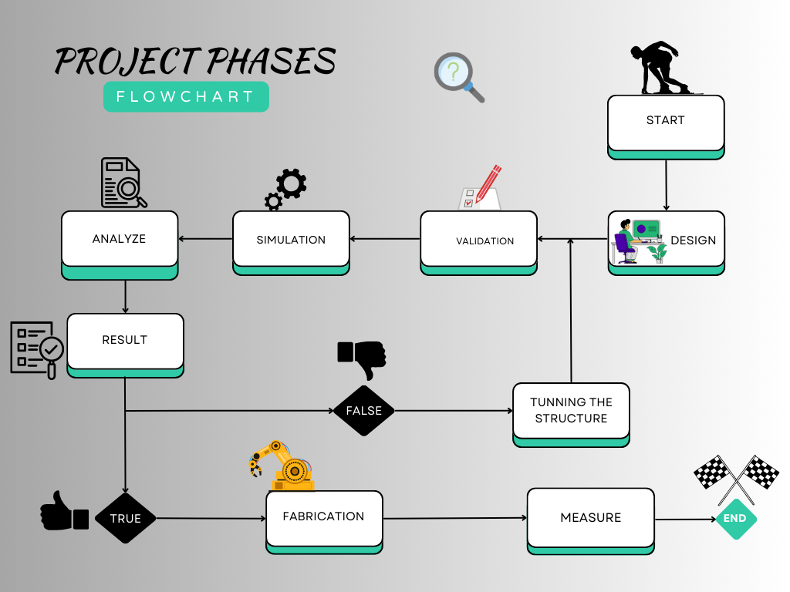
Architecture
Structural Block Diagram

Slide 10
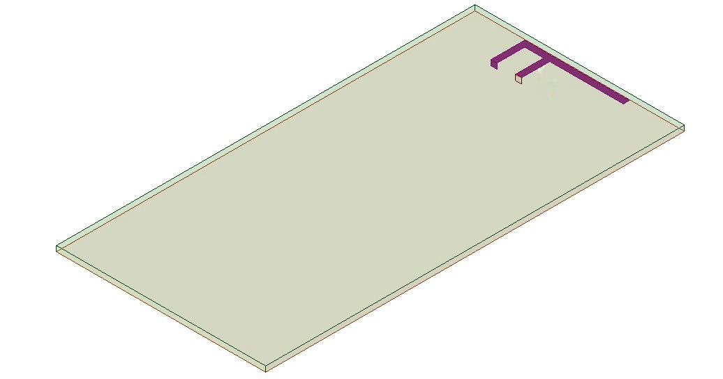
REVIEW-2
Structural Diagram
Dimensions:
Length 6.2 cm
Edge=3.1 cm
Thickness=0.08cmm

Slide 11
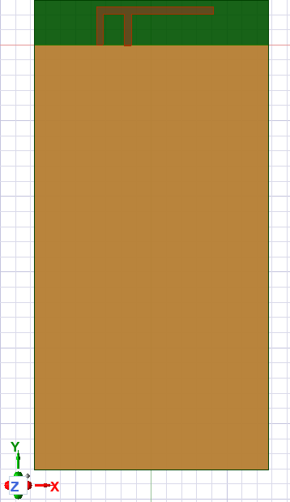
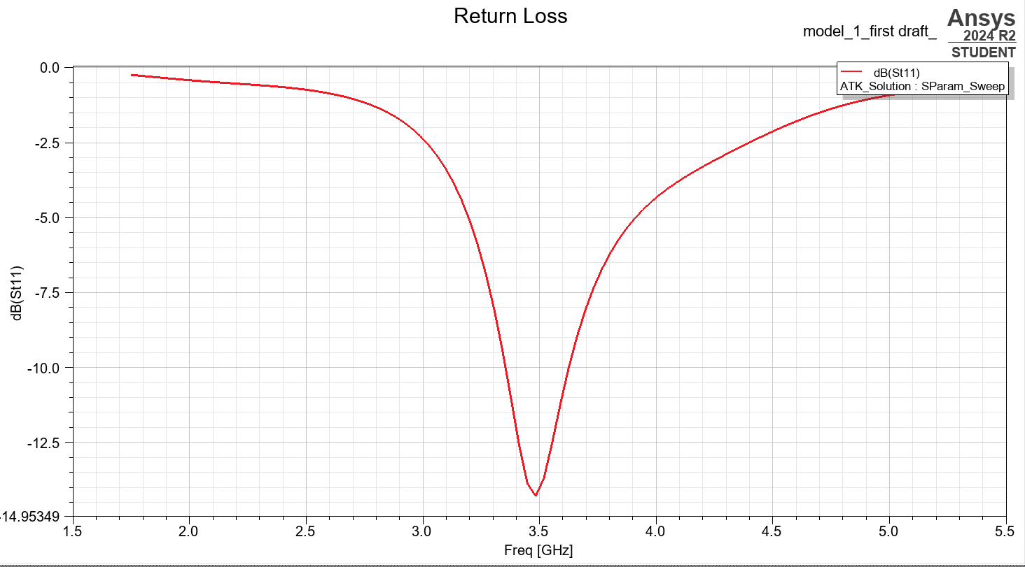
Implementation and Results-1

Slide 12
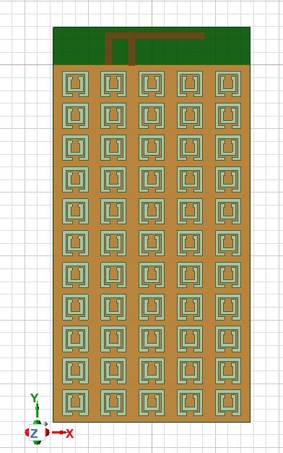
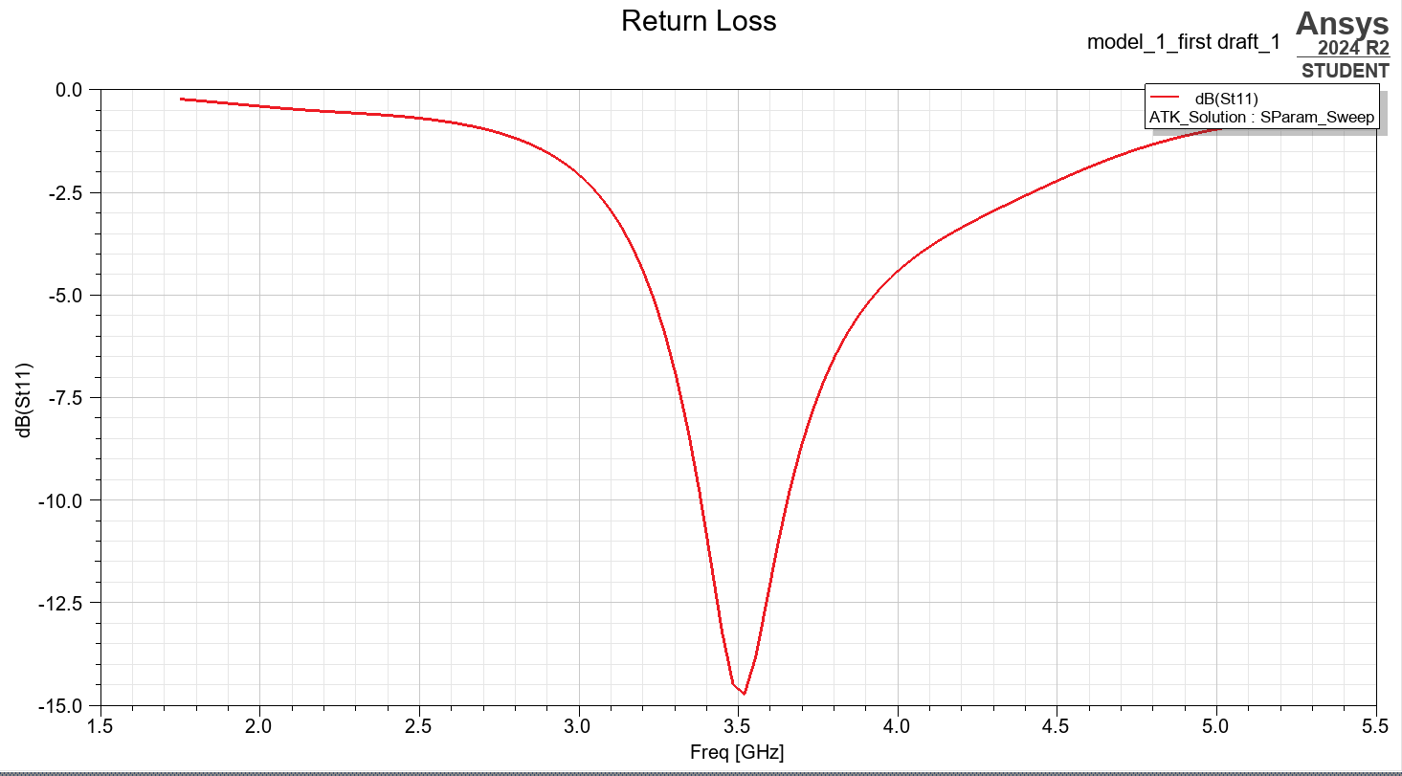
Implementation and Results-2

Slide 13
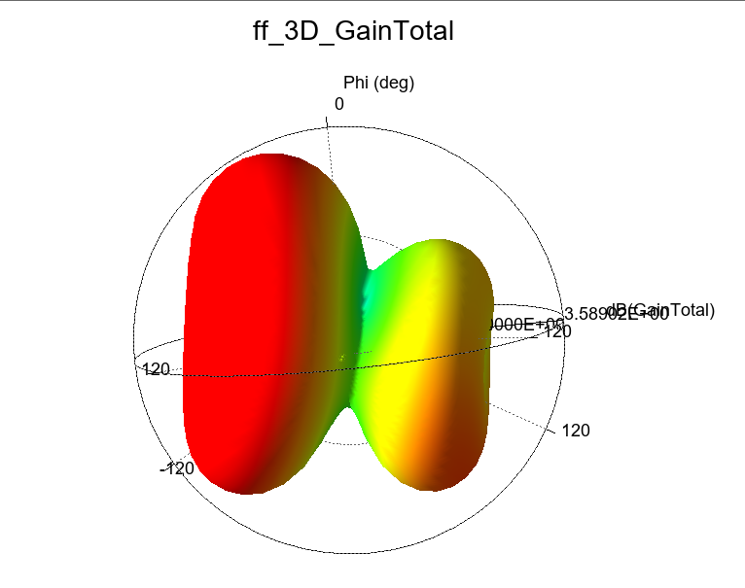

Slide 14
To calculate the bandwidth:
Bandwidth= fhigh​ −flow
Where:
fhigh​ ​is the higher frequency(around 3.85 GHz)
flow is the lower frequency (around 3.15 GHz)
Bandwidth=3.85GHz−3.15GHz=0.7GHz=700MHz

Slide 15
Summary and Conclusion
In our simulation using Ansys 2024, we designed a planar inverted f antenna (PIFA). by using the substrate fr4 . with further adding meta material to structure, without changing the feeding technique. this is an evidence that the PIFA antennas are very flexible in its capability to control return loss and to get expected gain pattern and therefore is best suited for automotive applications such as WIFI application.
Future Work
In the future work, we are focusing on enhancing the antenna design to get better bandwidth, especially operational range in the range of 3.5 GHz to 3.7 GHz. After that, we will be able to update our design for multiband functionality with wider frequency coverage. Then comes the embedding of the antenna in an ADAS setup. In this case, it will test how well the antenna performs in real-life automobile applications. That is important in strong communication or signal processing required for future car technologies.

Slide 16

THANK YOU

